Slide 1
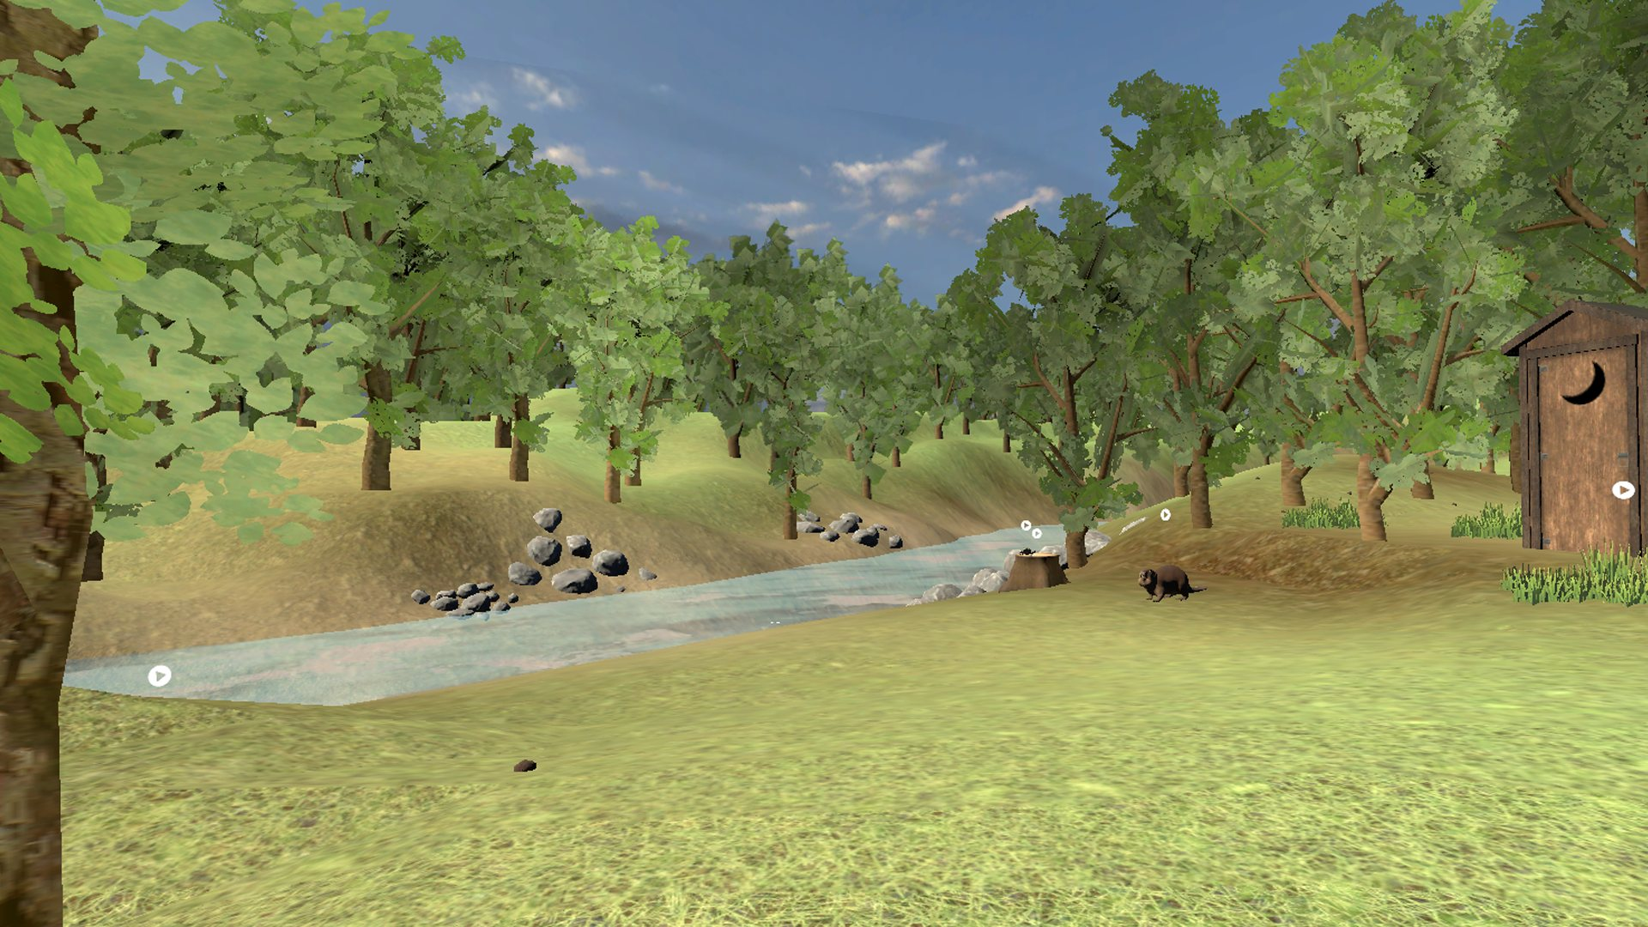
Digital World Building
RED RIVER COLLEGE POLYTECHNIC · WORKSHOP
Consider → Scope → Build: from an idea to an explorable world
Dann Blair · Founder & CTO, BSD XR
Notes:
Welcome. Today is hands-on: by the end you'll have scoped a world of your own and built it in the browser, no code needed. First, some foundations: what digital worlds are, where the metaverse idea came from, how worlds tell stories, and who owns what inside them.

Slide 2

Daniel Blair
// HELLO, I'M DANN
Educator · Researcher · Technologist
FOUNDER & CTO
BSD XR — applied AI + spatial computing
INSTRUCTOR
ACE Project Space, RRC Polytech
BOARD CHAIR
New Media Manitoba
Construction
Aerospace
Mining
Defence
Utilities
Award-winning entrepreneur and developer. Technology with purpose.
Notes:
Quick intro. I'm a hands-on developer who started a studio. BSD XR does applied AI and spatial computing for construction, aerospace, mining, defence and utilities, plus a lot of education work. I teach in the ACE Project Space here at RRC Polytech and chair New Media Manitoba. Today I'll show you how we think about building worlds, then you'll build one.

Slide 3
My path: developer, founder, educator
Build
Found
Share
Teach
Hands-on developer first, with roots that predate the studio
Started BSD XR; Clutch Top 15 Global AR/VR Developer and Top Unity Developer 2024
TEDx Winnipeg · MIT Reality Hack panelist · Future Leaders of Manitoba Award
Instructor, ACE Project Space, RRC Polytech · Board Chair, New Media Manitoba
I don't vibe code. I call it AI co-authoring: AI drafts, I stay the author, guided by the 4 Ds.
Notes:
A quick version of my story. Tell it in your own words: how you got into development, why you started BSD XR, a project that changed things. The point for students: the path wasn't planned, and the skills you're building today are the same ones I use. The 4 Ds come back in Part 2 when we scope with AI.

Slide 4
Foundations first, then we build
TODAY
Part 1 · Foundations
Part 2 · Workshop
What are digital worlds?
The metaverse
Digital storytelling
Digital identity & ownership
BSD XR: the worlds we build
Consider — the decisions behind a world
Scope — write it down, by hand and with AI
Tools — engines, Blender + Claude, ComfyUI
Build — best practices, then create your world
Playtest & wrap
Notes:
Two halves. Part 1 is about 50 minutes of context so we share a vocabulary. Part 2 is hands-on in groups of three. You'll leave with a World Brief of your own.

Slide 5
A digital world is a space you can be in — with its own rules, its own story, and a reason to be there.
01 · WHAT ARE DIGITAL WORLDS?
Not a website you read or a video you watch. A place you move through, act in, and come back to.
Notes:
Working definition for today. The key word is "in". A world gives you presence and agency. It has rules, even if the only rule is gravity. And it has a purpose, whether that's fun, learning, training or connection. Ask: what's a digital world you've spent real time in?

Slide 6
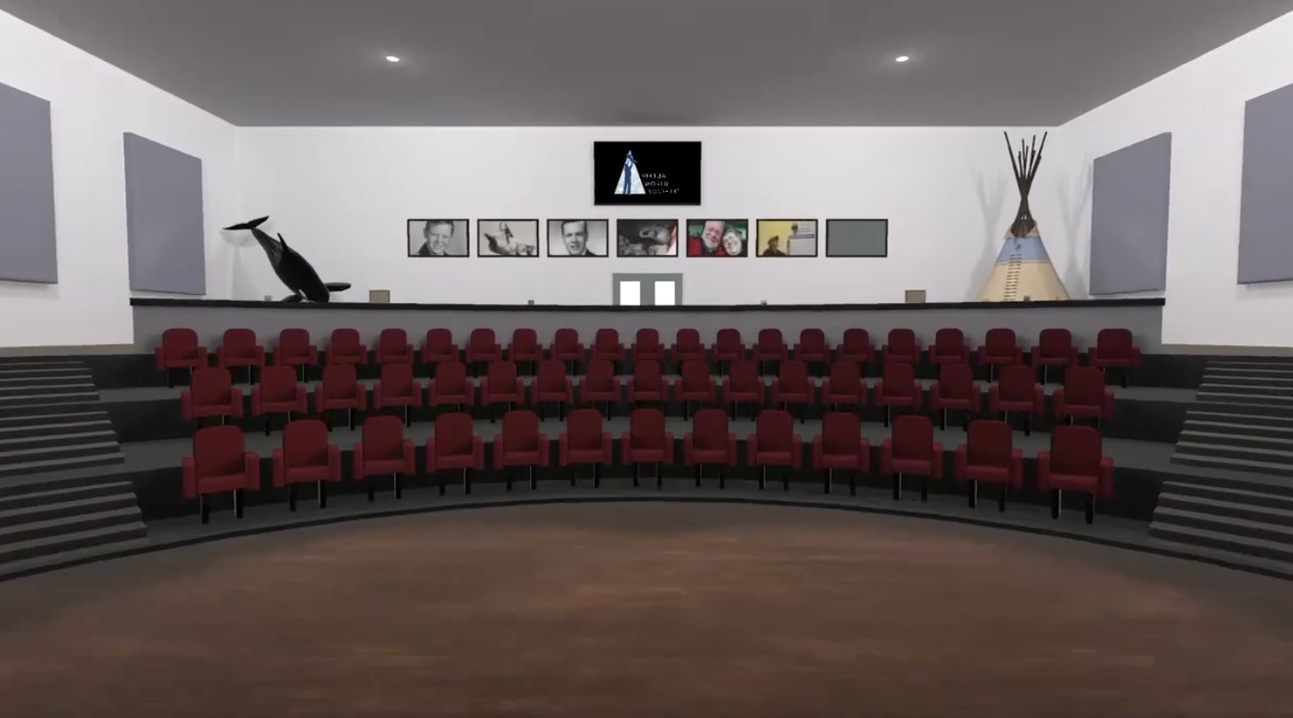
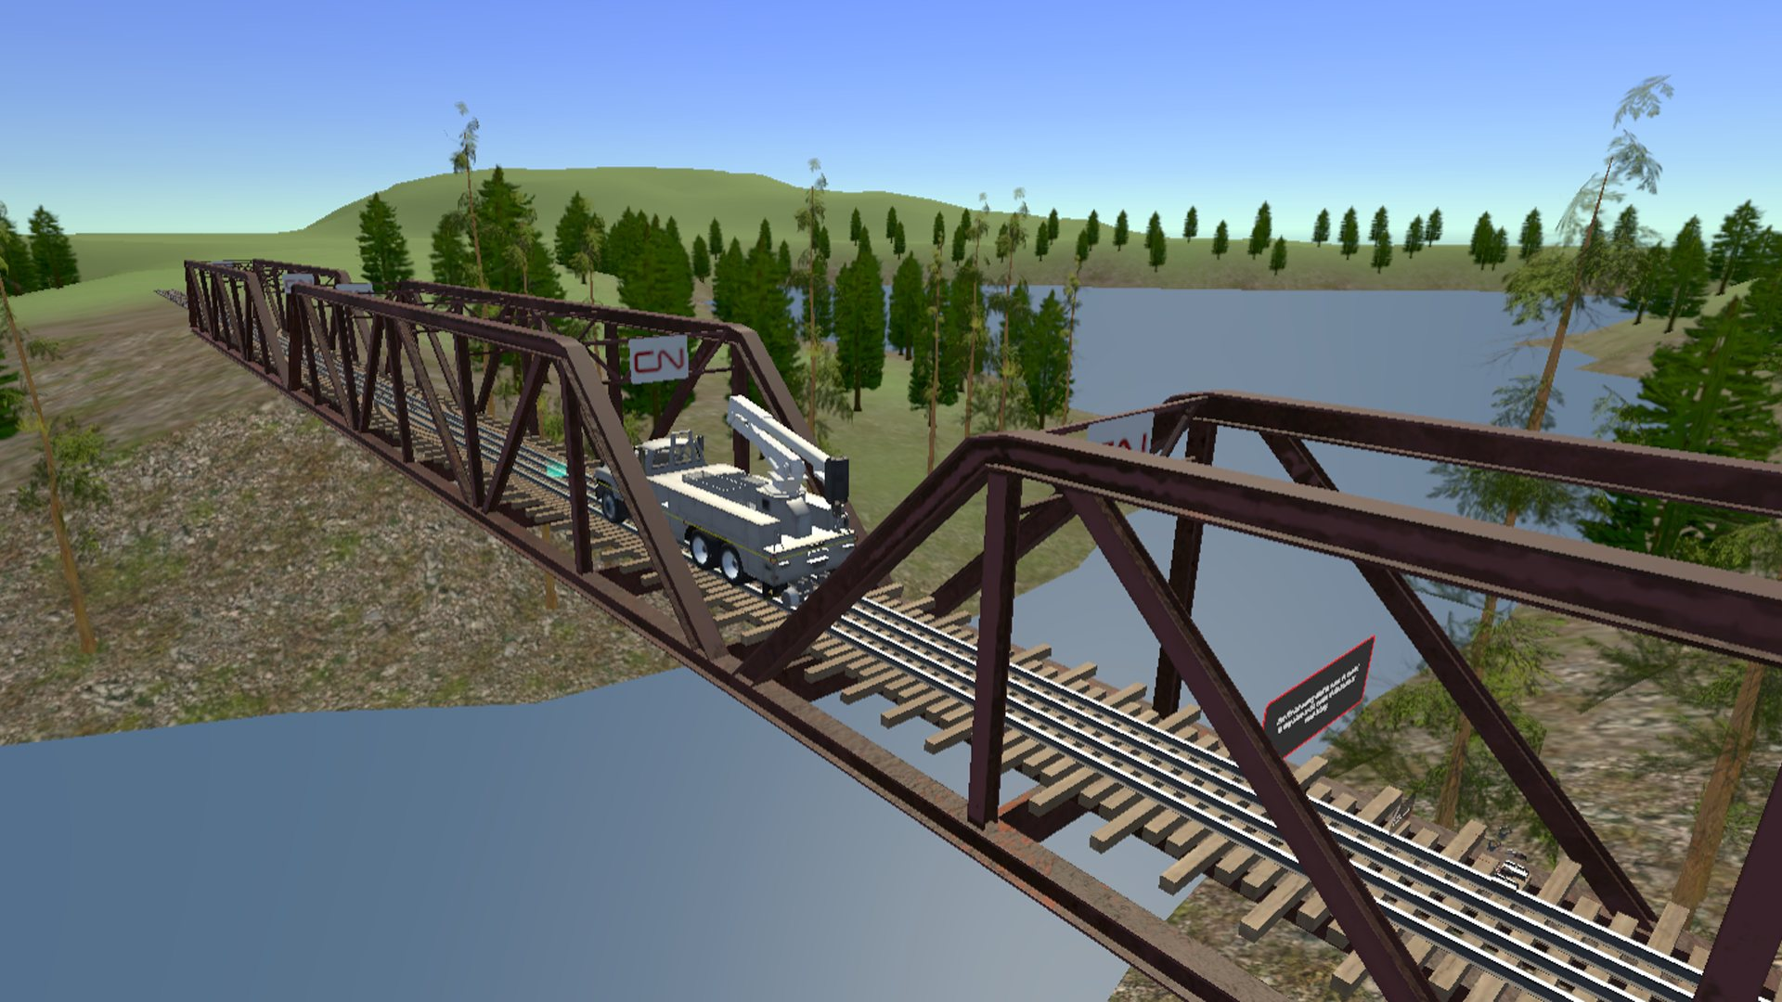
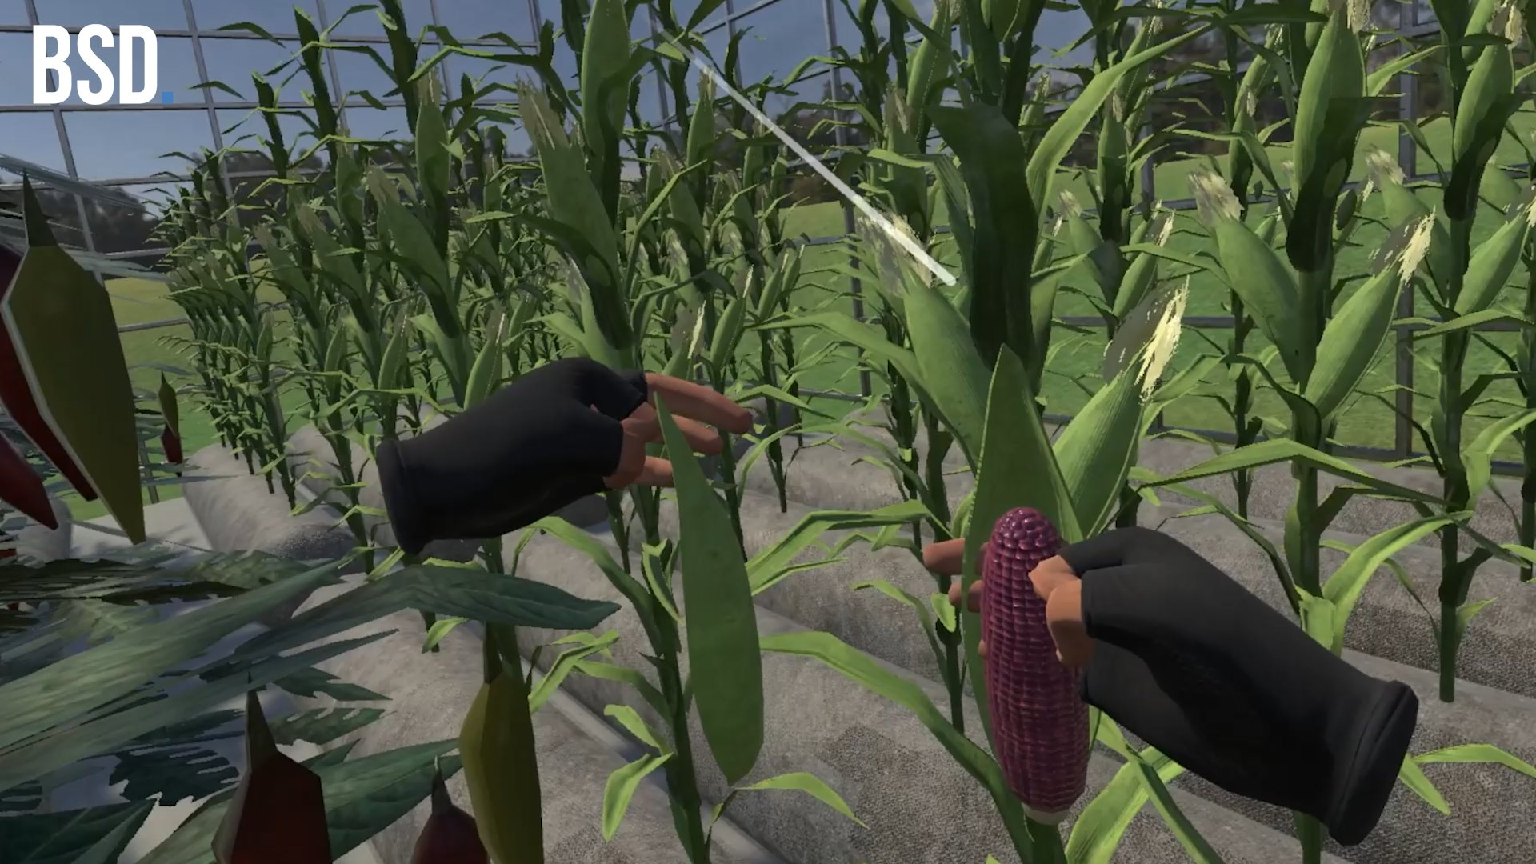
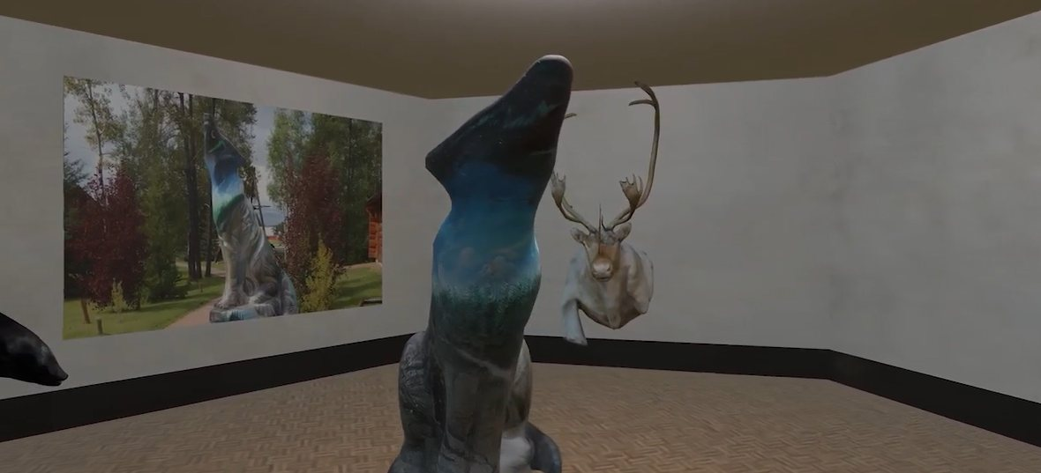
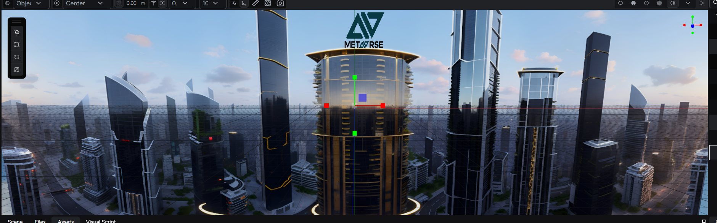
Worlds come in many kinds
Games
Social spaces
Training simulations
Play, challenge, adventure
Meet, gather, perform
Practise the dangerous safely
Digital twins
Museums & heritage
The spatial web
Mirror a real place or system
Preserve and share the past
Worlds behind a link
Notes:
Same craft, different purposes. Every image here is a world BSD XR has built or worked on. Notice that most of these aren't games: they're for learning, training, gathering and remembering. The skills transfer across all of them.

Slide 7





Five ingredients every world shares
Space
Presence
Rules
Story
Purpose
Somewhere to be, with scale and layout
The feeling that you are there
What's possible, and what happens when you act
A history and a reason to explore
Why it exists and who it's for
Miss one and people feel it, even if they can't name it.
Notes:
Keep these five in mind. We'll expand them into ten design considerations in Part 2. Presence is the one that's unique to worlds: a feeling of being somewhere, which VR makes stronger but a good desktop world can create too.

Slide 8
An idea from science fiction, 30 years in the making
02 · THE METAVERSE
1992
2003
2006
2017
2021
2024
Snow Crash by Neal Stephenson coins "the Metaverse"
Second Life: avatars, land and a user-built economy
Roblox launches: players become world builders
Fortnite: a game that becomes a venue for concerts and events
Facebook renames itself Meta. Peak hype
Apple Vision Pro brands it "spatial computing"
Notes:
The word is older than most of you. Stephenson imagined a single shared virtual street. Since then we've had waves: Second Life's virtual economy, Roblox and Minecraft turning players into creators, Fortnite turning a game into a venue, the 2021 hype peak when Facebook became Meta, and now the industry mostly says "spatial computing" instead. The idea keeps coming back because people keep wanting shared places online.

Slide 9
What people mean by "the metaverse"
Persistent
Real-time 3D
Shared
It keeps existing when you log off
Rendered live, explored freely
Many people, at the same time, in the same place
Present
Interoperable
Continuous
Each person feels like they're there
Worlds connect; you can move between them
Your identity, items and history come with you
Adapted from Matthew Ball, The Metaverse: And How It Will Revolutionize Everything (2022)
Notes:
Matthew Ball's definition is the most useful one I know. Most worlds today hit the first four. The last two, interoperability and continuity, are the hard part, and they're mostly unsolved: your Roblox avatar doesn't walk into Fortnite. That gap is exactly where the identity and ownership questions come from, which we'll get to shortly.

Slide 10
XR is every way of stepping into a world
XR · EXTENDED REALITY
The real world
A fully virtual world
AR
MR
VR
AUGMENTED REALITY
MIXED REALITY
VIRTUAL REALITY
Digital layered onto the real world: phone, tablet, glasses
Real and virtual share the room and react to each other
You step fully inside; the real world disappears
After Milgram & Kishino's reality–virtuality continuum (1994)
Notes:
XR, extended reality, is the umbrella term. Think of it as a dial rather than three boxes: from the real world with a little digital on top, through mixed reality where virtual objects sit on your real table, to VR where you're fully somewhere else. Today's headsets slide along the whole dial using passthrough cameras.

Slide 11

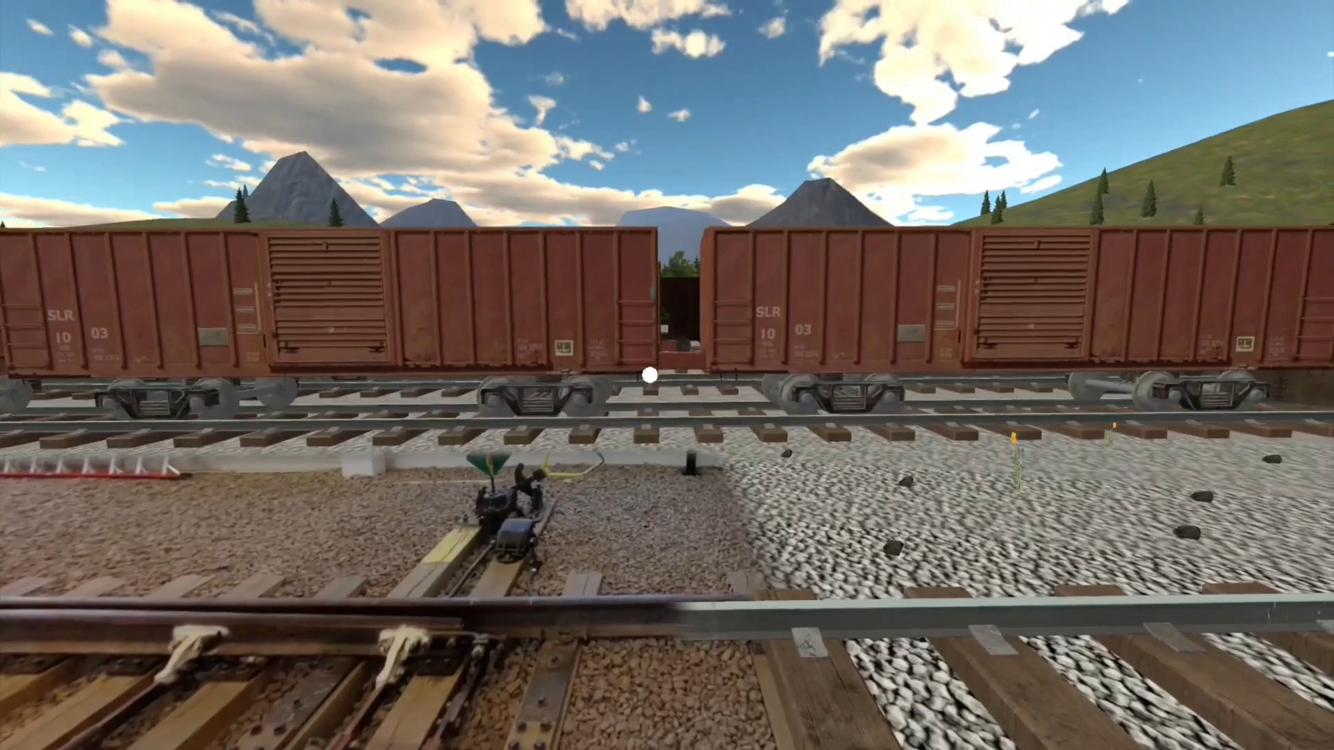
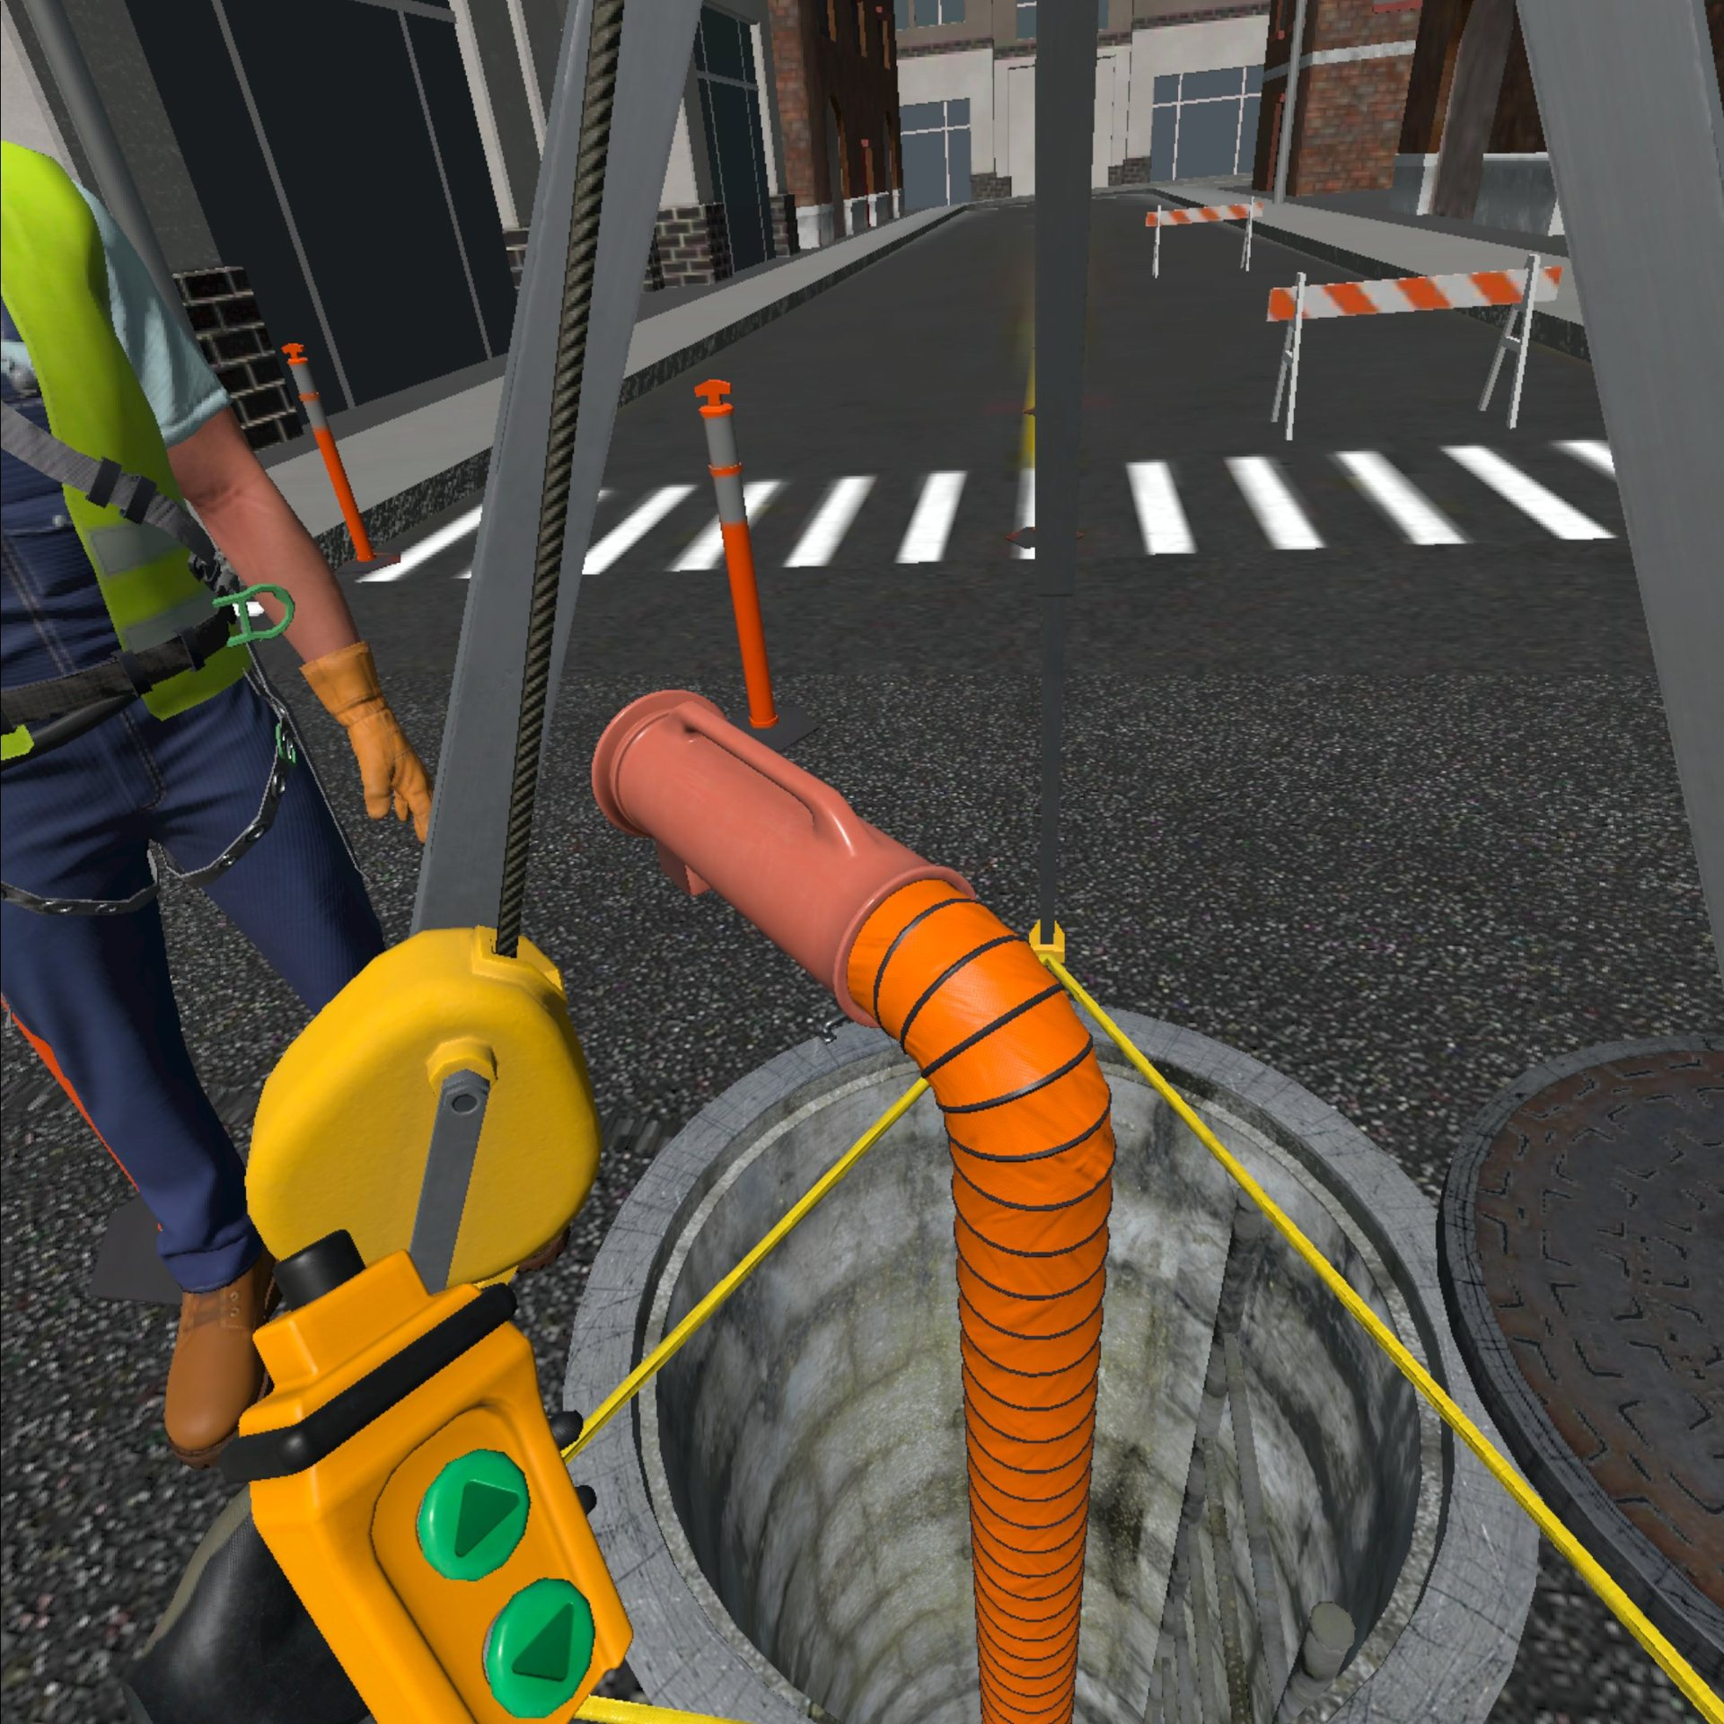
XR takes the metaverse off the screen
AR · THE WORLD COMES TO YOU
MR · YOUR BODY IS THE CONTROLLER
VR · YOU GO TO THE WORLD
Fossil Discovery Adventure
Confined Space VR
A life-size mosasaur appears inside the museum in Morden
The Grid: Near Miss
A silo, a sewer, a crawl space, with no real risk
Passthrough training: throw a real switch, look both ways
Notes:
Back to Ball's properties: XR is what makes "presence" real. On a screen you watch a world; in XR you're in it, and your body becomes the input. And with AR and MR the metaverse stops being somewhere else: it gets anchored to real places, like the fossil centre in Morden or a CN rail yard. All three examples are BSD XR projects.

Slide 12
What XR changes for world builders
Scale is felt
The body is the input
A door that's 10 cm too short feels wrong instantly
Hands, head, gaze and voice replace buttons
The room is part of the level
Comfort is a requirement
Real walls, tables and people shape what fits
Teleport, steady frame rate, no forced camera moves
Notes:
These four feed straight into the ten considerations later: platform, space, comfort and access. They're also why the World Seed editor works in real metres.

Slide 13
There is no one metaverse — there are many worlds, and the ones that last have a job
What was hyped
What stuck
Buying virtual land as an investment
One platform for everything
Everyone working in VR all day
Training and simulation
Games as social places
Digital twins, museums and education
3D on the open web
Notes:
My take from the studio side. The hype cycle crashed, but the useful parts kept growing quietly. Every successful world I've worked on had a clear job: train a rail worker, teach a language, preserve a museum collection, bring people together. That's the lens for today: purpose first.

Slide 14
In a world, the space is the story.
03 · DIGITAL STORYTELLING
Film tells you what happened. A world lets you find out.
Notes:
This is the big shift from linear media. In a film the director controls the camera and the order. In a world, the visitor controls both. So the story has to live in the space itself: in what's placed where, what's left behind, what happens when you act.

Slide 15
Four ways a space tells a story
Evoked
Enacted
Borrows a story you already know: a haunted house, a frontier town
You perform the story: the quest, the rescue, the climb
Embedded
Emergent
Clues placed in the space: a journal, a broken door, an empty chair
Stories that arise from rules and players, not a script
Henry Jenkins, "Game Design as Narrative Architecture" (2004)
Notes:
Jenkins' four types are a great toolkit. Most good worlds mix them. When you build your own world today, try one embedded clue: an object left behind that tells part of the story.

Slide 16

Every word brings you closer to home
STORY THROUGH MECHANICS
Reclaim! Azhe-giiwewining — a point-and-click adventure where learning Ojibwe words is how Miskwaa finds her way back to her grandmother.
With Grassroots Indigenous Multimedia · on Steam
Notes:
Here the core mechanic IS the story. You don't read about reconnecting with language; you do it, word by word. Also a model for cultural work: built with and for community, with the language and stories led by the people they belong to.

Slide 17
Forget to look both ways, and the train arrives
STORY THROUGH CONSEQUENCE
The Grid: Near Miss for CN Rail — mixed-reality training where you throw a real switch, "Point and Call", and live with the result.
Notes:
Training worlds tell stories too. The story here is "the day I almost didn't look". A safe, memorable near miss builds the muscle memory that prevents a real one. Consequence is one of the strongest storytelling tools a world has.

Slide 18



Who are you in a world?
04 · DIGITAL IDENTITY & OWNERSHIP
Avatar
Presence
Persistence
How others see you — chosen, scanned or assigned
How it feels to be you, there — voice, hands, gaze
What the world remembers about you between visits
The Proteus effect: people tend to behave like their avatar looks. Design choices shape behaviour.
Yee & Bailenson, "The Proteus Effect" (2007)
Notes:
Identity in a world has layers. The avatar is the visible one. Presence is how your real body shows up: tracked hands, voice, where you look. Persistence is the record. Research by Yee and Bailenson found people given taller or more attractive avatars behaved more confidently. So identity design isn't cosmetic; it changes how people act.

Slide 19
What do you actually own in a world?
What it feels like you own | What you usually have
A skin or item you paid for | A licence, under the platform's terms
A world or object you built | Rights that depend on the platform's terms
Your avatar, voice or 3D scan | A likeness you may have licensed to the platform
Your behaviour in the world | Data the platform collects — movement, gaze, voice
NFTs promised portable digital ownership; the 2021 boom faded fast in 2022. The question they raised — can you leave with what's yours? — is still open.
Notes:
Most people are surprised by this table. In nearly every platform, what you "buy" is a licence. What you build is governed by terms of service. XR also collects unusually personal data: how you move and where you look. NFTs tried to solve portability and mostly became speculation, but the underlying question is real and still unanswered. As builders, we get to decide how fair our worlds are.

Slide 20
When a world holds a community's knowledge, who controls it?
OWNERSHIP OF KNOWLEDGE
Ownership
Control
Access
Possession
OCAP® — First Nations principles for how data and knowledge are governed
OCAP® is a registered trademark of the First Nations Information Governance Centre (FNIGC) · Image: Myera Farms digital twin
Notes:
Ownership isn't only about skins and land. Projects like the Myera Farms digital twin carry Indigenous Traditional Knowledge. OCAP, from the First Nations Information Governance Centre, sets out that communities own, control, access and possess their own data. For anyone building worlds in Manitoba, that's a design requirement from day one, not a legal footnote.

Slide 21
Five questions every world builder should answer
1
Who owns what people make here?
2
What data do we collect, and why do we need it?
3
Can people leave with what's theirs?
4
Whose culture, place or likeness are we using — and who said yes?
5
How do people choose how they appear — and stay safe?
Notes:
These go straight into the scoping document you'll write later. They sit under "Culture & ethics" and "Constraints". Answer them early; they're expensive to retrofit.

Slide 22
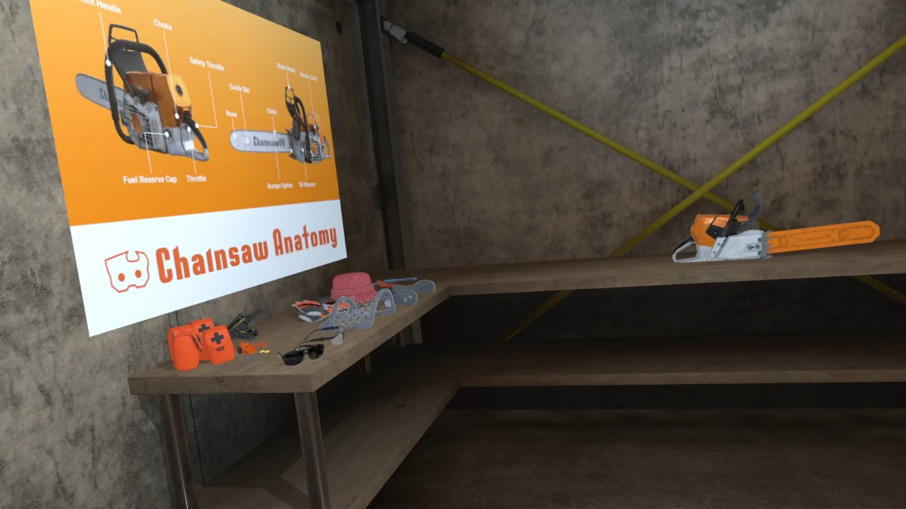
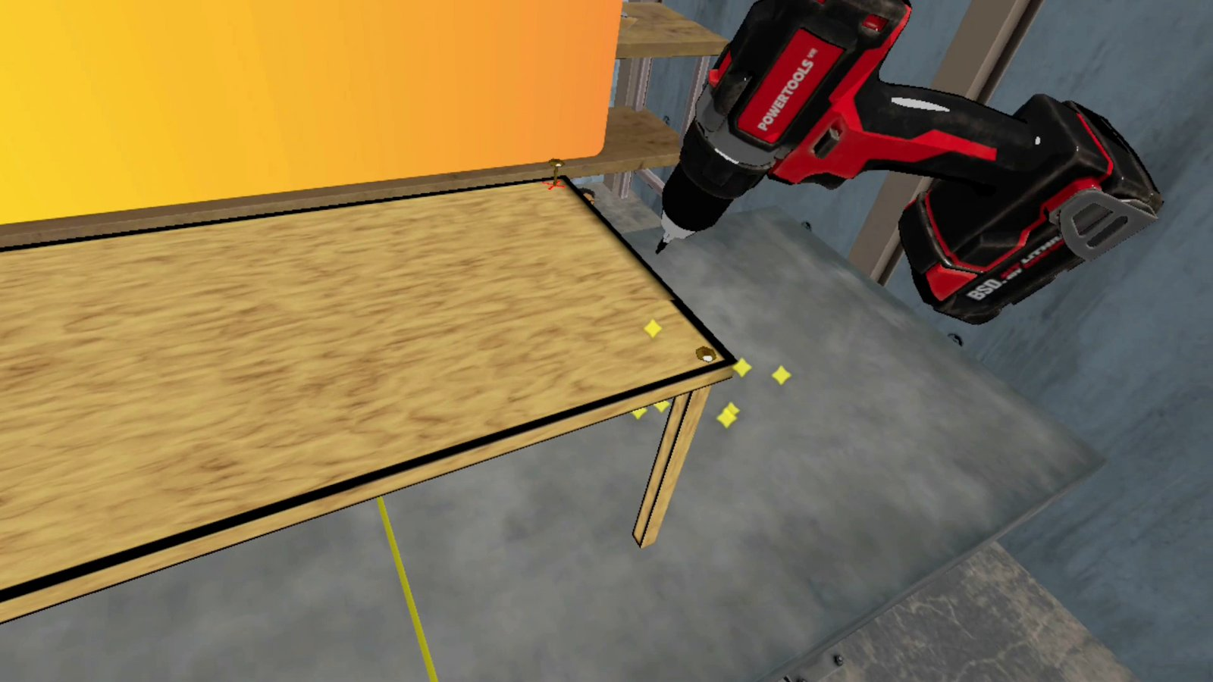
Built in Manitoba, used on the job
// TRADES & SAFETY
CN Rail · Working at Heights
MadeSafe · Confined Space
CN Rail · Near Miss
Mixed reality: throw a real switch, Point and Call, gaze-validated safety checks
MCSC + WCB · Chainsaw VR
MCSC · Power Drill VR
Notes:
Same set I showed at UCN Linkages. Near Miss is the hero: mixed reality on the Pico 4 Ultra Enterprise, where you physically throw a switch. Chainsaw VR was built with MCSC and funded by WCB: PPE, inspection, then cutting at a logging site, with "harm consequences" like a slow-motion replay when you make a dangerous mistake. Power Drill VR is the opposite end: cartoonish and playful, a digital open house to get kids excited about the trades. Same craft, very different worlds.

Slide 23
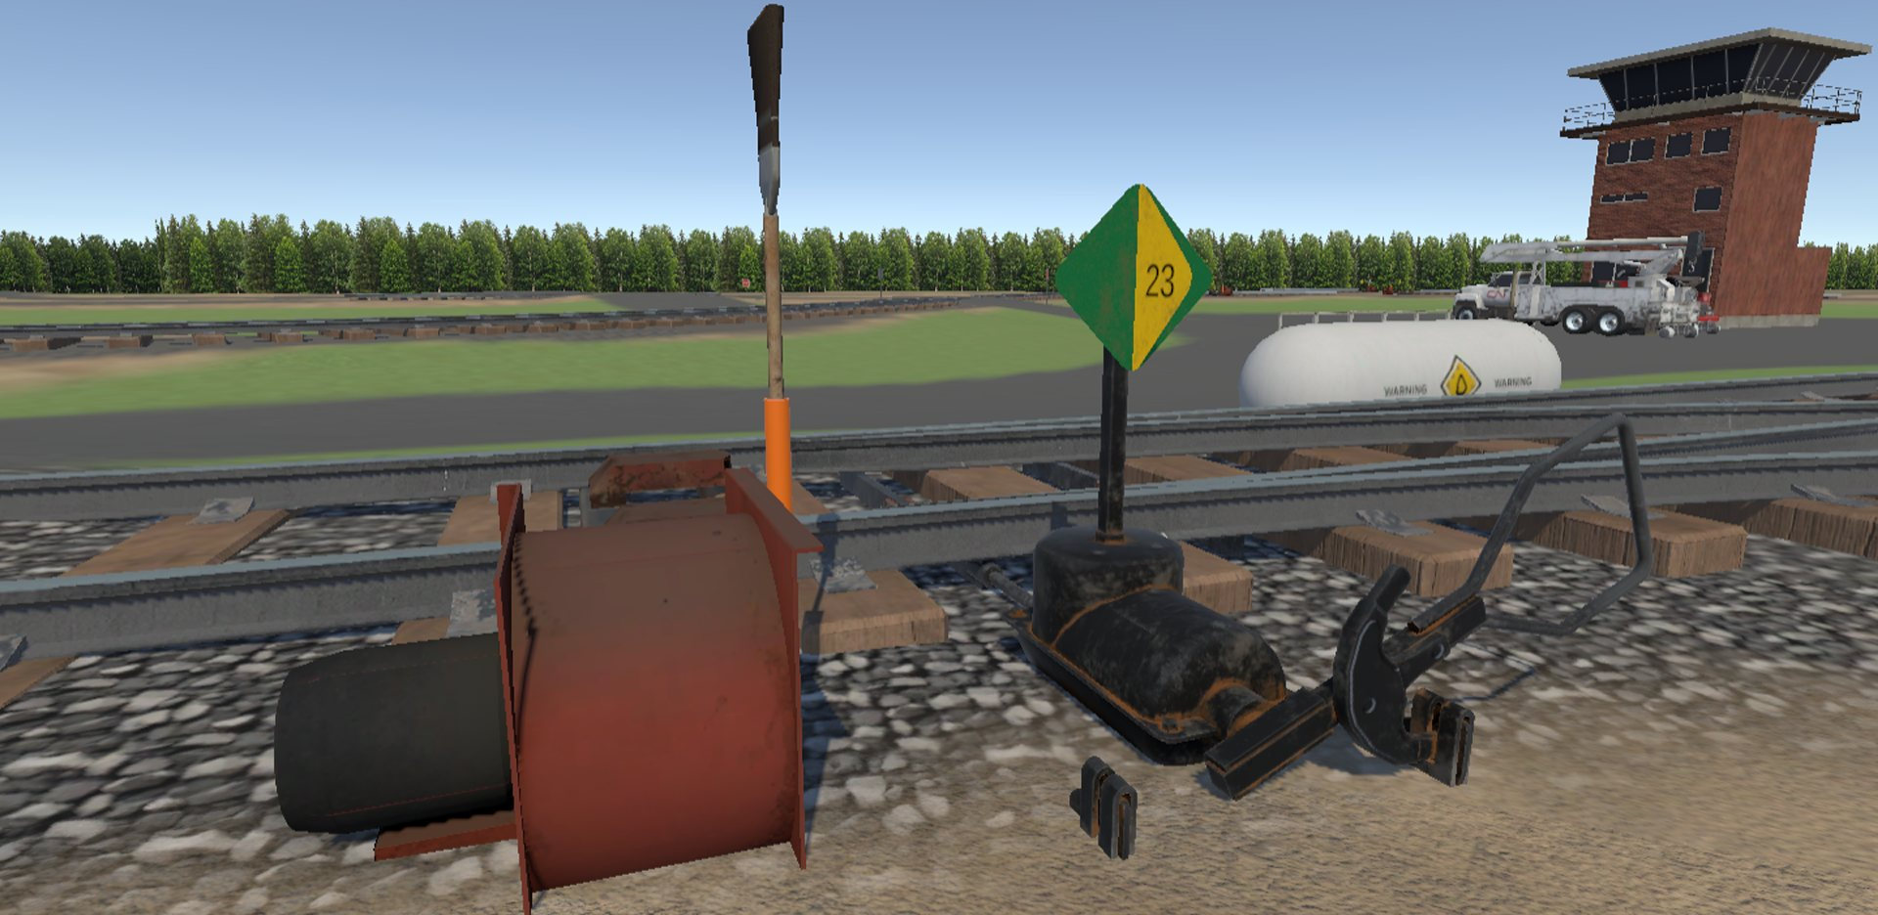
One world, many lessons
CASE · CN RAIL
The Grid is a family of training modules — Working at Heights, Switches & Routes, Near Miss, Slack Simulator — built on shared rail environments.
World-building lesson: build a modular kit once, then reuse it for every scenario.
Notes:
The Grid shows the value of thinking at the world level, not the scene level. Tracks, switches, yards and bridges are a kit. Each new module is a new story told in the same world, which makes each one faster and cheaper to build. We'll talk about modular kits in the best-practices section.

Slide 24
Bringing northern museums to anyone
CASE · CEDF
A VR museum of northern Manitoba history, with 3D-scanned artifacts placed in custom exhibit worlds.
Lesson: capture the real thing, then design the space around it.
Notes:
For the Communities Economic Development Fund. Real artifacts, like a mine detonator, a bear and a typewriter, were scanned and reconstructed, then placed in designed exhibit rooms. Capture gives you authenticity; world design gives you the visit. It also raises the ownership questions from earlier: whose artifacts, whose stories, who decides how they're shown.

Slide 25
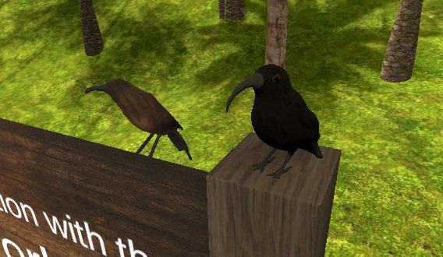
Worlds for gathering and belonging
VWS Amphitheater
Hawaiian Cultural Worlds
For the Virtual World Society on ENGAGE: a stage, breakout tables and a wall that tells the society's history.
Native flora and fauna, labelled in Hawaiian and English — a living encyclopedia to explore.
Notes:
Social worlds are designed around people, not tasks. Notice the embedded storytelling on the VWS timeline wall, and the identity layer in the Hawaiian world: language on every object says whose place this is.

Slide 26
What good immersive worlds get right
// WHAT WE'VE LEARNED
01
Start from a real problem, incident or near miss, not the technology
02
Build it with the people who live it
03
Measure what people did, not just that they finished
04
Keep it short enough to repeat
05
Run it where people live and work
Notes:
The five lessons from my Linkages keynote, framed for world builders. Every one of these shows up in your scoping work today: 01 is Purpose, 02 is Culture and consultation, 03 is Interactions, 04 is Scope, 05 is Platform.

Slide 27
Two ways into a world.
PART 2 · THE WORLD SEED DEMO
01 · LEARN
02 · CREATE
Developing for WebXR
Build your own world
How a world gets built for the browser and the headset
Design it and view it in the browser. No code.
Plus an optional challenge: take the repo, extend the tool, build something bigger.
Notes:
Open the World Seed demo on the projector. Start with the Learn section: walk through how a WebXR world is put together, so the ten considerations that follow have something concrete to point at. Then tell the room the plan: after scoping they'll use the Create section to build their own world in the browser, no code needed. For anyone who wants more, there's an optional challenge at the end.

Slide 28
Ten questions every world must answer
Consideration | The question
Purpose & audience | Why does it exist, and who is it for?
Platform & constraints | Browser, phone, headset? What does that cost us?
Experience & verbs | What does a visitor do in the first 60 seconds?
Space & wayfinding | How is it laid out, and how do people find their way?
Story & lore | What happened here before you arrived?
Rules & systems | What's true here — time, weather, physics, economy?
Look, sound & mood | Three mood words, five colours, one sound
Comfort & access | Motion comfort, seated play, captions, contrast
Culture & ethics | Whose places, symbols and stories? Who said yes?
Scope & feasibility | What can we build with our time, skills and budget?
Notes:
Expand the five ingredients into ten working questions. Discussion: name a world you love — which of the ten did it nail, which did it ignore on purpose?

Slide 29
A world is scoped in layers
1 · World Brief
One page: purpose, pillars, experience
SCOPE
2 · World Bible
Lore, rules, tone, naming
3 · Spatial Plan
Map, zones, paths, landmark, scale
4 · Asset List
Every object, its source and budget
Each layer is only as detailed as the build needs.
5 · Interaction Spec
Trigger → response
6 · Build Plan
Milestones and what "done" means
Notes:
The scoping stack. Today we focus on layer 1, the World Brief, because everything else grows from it. Groups taking on the optional challenge will want layers 3 to 6 too.

Slide 30
Two paths to a brief: by hand, or with AI and the 4 Ds
Step | By hand | With AI
Frame | Whiteboard the ten questions | Direction: set goal, audience, limits first
Generate | Sticky notes, sketches, mood board | Description: a prompt chain, not one prompt
Judge | Group critique against pillars | Discernment: cut the generic and the wrong
Hand off | Brief goes to the team | Delegation: AI drafts; humans own taste
AI is fast at volume and structure. You own the pillars, the culture and the final call.
Notes:
Same destination, two routes. The 4 Ds keep AI useful: Direction before you prompt, Description through a chain of prompts, Discernment on every output, and a clear line on what you Delegate.

Slide 31
Brief it twice
ACTIVITY · 25 MINUTES
10 min
10 min
5 min
By hand
With AI
Compare
Write a one-page World Brief for your world idea
Ask AI to interview you, draft the brief, then critique it
What did AI add that's good? Generic? What only you knew?
Output: one revised World Brief per group. You'll build it in the browser after the break.
Notes:
Manual first, so groups own the pillars before AI touches them. Then AI: interview, draft, critique. The compare step is where the learning happens. Groups keep their briefs: it's the plan they build from after the break.

Slide 32
Break · 10 minutes
Next: we build one of your worlds, live.
Notes:
Facilitator: start the World Seed editor (node server.mjs in the demo folder) or open the GitHub Pages link, and check it loads on a participant laptop.

Slide 33
Four ways to bring a world to life
TOOLS · GAME ENGINES
 | Godot | Unity | Unreal | Web (A-Frame)
Cost | Free, open source | Free under $200K | 5% after $1M | Free, open source
Language | GDScript, C# | C# | Blueprints, C++ | HTML, JavaScript
Strength | Light, gentle start | XR and mobile reach | Top-end visuals | Runs from a link
Watch for | XR still maturing | Terms have changed | Heavy hardware | Performance ceiling
Licence terms as of fall 2026 — check before you commit. Unity: Personal plan under $200K revenue or funding. Unreal: per title, lifetime gross.
Notes:
There's no best engine, only the best fit. Godot is free, MIT-licensed, tiny and friendly; great for learning and stylised worlds. Unity is what BSD XR uses most: the widest XR and mobile support and the biggest tutorial library; the runtime fee was cancelled in 2024 and it's seat-based now. Unreal is free until a title earns a million dollars, then 5%; it's the visual high end, and Blueprints let non-coders build. The web, which is what our demo uses, runs from a link with no install.

Slide 34
Let the brief choose the engine
"It has to open from a link, on any device"
→ Web, or Godot
"It has to run on a standalone headset"
→ Unity
"Photoreal is one of our pillars"
→ Unreal
"Nobody on the team codes yet"
→ Godot, or Blueprints
> Problem → People → Process → Tool. The tool comes last.
Notes:
Point back to the Platform and Scope considerations. The engine is a consequence of the brief, not the first decision. Teams pick engines by habit and then fight them.

Slide 35

From an idea to an asset in your world
TOOLS · ASSET PIPELINE
01
02
03
04
Asset list
ComfyUI
Blender + Claude
Engine
What, where, how many triangles
Concept image, texture, or a rough mesh
Build, clean up, scale, name, export
GLB in, test at true scale
AI speeds up every step. The asset list still decides what gets made.
Notes:
This is the pipeline we'll demo. Start from the asset list, generate a concept or a rough mesh in ComfyUI, then use Claude driving Blender to build or clean it up, set real-world scale, name it, and export a GLB. Then test in the engine. CC0 libraries like Poly Haven and Kenney are always a valid shortcut too.

Slide 36
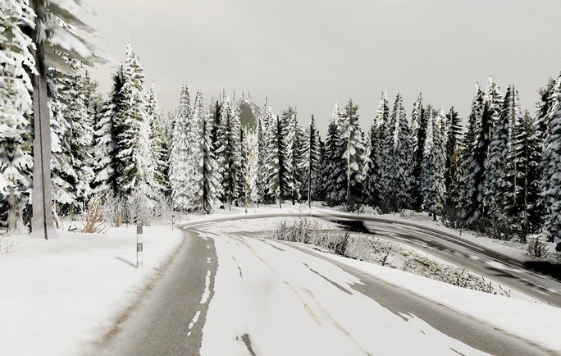
AI makes the first version cheap again
// WHY I'M OPTIMISTIC
THEN
"Show me it's possible."
NOW
"Show me it's finished."
Don't skip the step where you learn. Use cheap AI drafts to greybox faster, not to skip the greybox.
A winter forest XR world, generated with AI
Notes:
From my Linkages keynote. AI makes building look cheap, so the first version is now expected to be finished, integrated and ready to scale. That's a trap for world builders: the greybox stage is where you learn whether the layout, scale and story work. Use AI to get to a testable first version faster, then playtest it, rather than polishing something nobody has walked through.

Slide 37
Describe it in words, watch it appear in Blender
LIVE DEMO · BLENDER + CLAUDE
How it works
What we'll do
The Model Context Protocol (MCP) connects Claude to Blender. Claude reads your scene, writes Blender Python, runs it, and checks the result.
1. Build a lantern from the asset list
2. Fix scale, pivot and names
3. Export a GLB
4. Import it into the World Seed editor
Official Blender Lab MCP server (Blender 5.1+) · community "MCP for Blender" adds Poly Haven, Sketchfab and AI model generation
Notes:
Switch to Blender with Claude connected. Prompt something like: "Build a low-poly wooden lantern post for a park path: 2.2 metres tall, warm amber light at the top, under 800 triangles, pivot at the base. Name it dock_lantern_a." Show Claude inspecting the scene, writing the code and taking a screenshot to check its work. Then ask it to export a self-contained GLB with embedded textures and no Draco compression, which is what the World Seed editor imports, and drop it in. Safety note: MCP runs the code Claude writes in Blender without guards, so save first and demo on a copy. The official server is from Blender Lab; the community one adds asset libraries and generation services.

Slide 38

One node graph: images, video and 3D
LIVE DEMO · COMFYUI
Images
Video
3D
Concept art, mood boards, textures and skyboxes
Animatics, mood clips, trailer beats
Image to textured mesh, then clean-up in Blender
Runs on your own GPU. Every step is a visible node, so you can see and share the whole recipe.
Notes:
Switch to ComfyUI. Image: generate a concept of one building from a group's brief, using its palette and mood words. Video: turn that frame into a short mood clip. 3D: feed a clean object image, such as the lantern, into an image-to-3D workflow; TRELLIS.2 and Pixal3D are now native in ComfyUI and output textured meshes. Open the result in Blender and compare it with what Claude built. Point out that the graph itself is the documentation. Model choices change monthly, so pick and test the exact models a day before.

Slide 39
Four guardrails for AI-made assets
Check the model's licence
Ask before you generate
Not just the output: some models restrict commercial use
No real people, logos or cultural designs without permission
Label it
Clean it up
Mark AI-generated assets in your licence ledger
Fix scale, triangle count, holes and UVs before it ships
Notes:
This connects back to identity and ownership in Part 1. Generative tools make it easy to produce something that isn't yours to use. Same discernment as the brief: does it serve the pillars, is it ours to use, is it buildable.

Slide 40
Build in stages — greybox first, polish last
BUILD
1
2
3
4
5
Greybox
Blockout
Art pass
Life
Polish
Prove layout, scale and flow with boxes
Zones, paths, landmarks, sightlines
Palette, style, lighting from the brief
Interaction, audio, story beats
Fog, particles, tuned to budget
Changing a box costs seconds. Changing a finished building costs days.
Notes:
When you build in the World Seed editor, start with plain primitives: that's your greybox. Greybox is the most skipped and most valuable stage. Point out true scale: one unit equals one metre, eye height 1.6 metres.

Slide 41
Habits that keep worlds buildable
Real scale
Wayfinding
Modular kits
Budgets
1 unit = 1 metre. Doors 2.1 m, eyes 1.6 m
A landmark visible from everywhere; light leads the eye
Reusable pieces, shared pivots, snap to grid
Set triangle, draw-call and frame-rate targets up front
One style
Licence ledger
Commit small
Scope = truth
Consistency beats fidelity
Log the source and licence of every asset
Version control from day one
When world and doc disagree, fix one on purpose
Notes:
Quick tour. Scale is the number-one immersion breaker. Budgets matter most on headsets: aim for 72 to 90 frames per second on a Quest.

Slide 42
Build your world in the browser. No code.
YOUR TURN · WORLD SEED: CREATE
1
2
3
4
Greybox
Dress it
Light it
Save & view
Block out zones, paths and the landmark with plain shapes
Add objects, colours and your own GLB models
Set the mood your brief describes
Save it, then view your world in the browser
Your World Brief is the plan. Every object should answer to it.
Notes:
Groups build the world they scoped, in the Create section of World Seed. No code. Push them to greybox first with plain shapes at real scale, metres, before decorating. Groups that made a model in the Blender or ComfyUI demos can import it as a GLB. Save often and export a JSON copy before the playtest. About 25 minutes.

Slide 43
Vibe coding vs AI co-authoring
// HOW WE'LL USE AI TO BUILD
 | Vibe coding | AI co-authoring
Who's the author? | The vibes | You are. Your name is on it.
The output | Forget it exists | Read it, test it, own it
The goal | Make it look done | Make it right for here
Best for | Throwaway experiments | Anything someone relies on
Rule of thumb: if your name is on it, you read all of it.
Experienced developers using AI were 19% slower on real tasks, yet believed they were 20% faster. METR randomized trial, July 2025
Notes:
Set up the optional challenge with this. Karpathy coined "vibe coding" in February 2025: give in to the vibes and forget the code exists. Great for a weekend prototype, risky for anything someone relies on. If you extend the World Seed tool with Claude Code, co-author it: your brief gives direction, Claude drafts the code, and you read the diff and walk the world before you accept it. The METR finding is why: feeling fast is not being fast.

Slide 44



Extend the tool. Grow the world.
OPTIONAL CHALLENGE
Take the repo
Extend the tool
Build bigger
Fork World Seed from GitHub and run it on your machine
Add a feature your world needs: a new object, an interaction, sound
A larger, multi-zone world, published to a link
Use Claude Code as a co-author. Your name is on it, so read every line.
github.com/CMDann/digital-world-building
Notes:
For students who finish early or want to keep going after today. Fork the repo, run the editor locally, then use Claude Code to add one feature your world actually needs. Write it down as a short brief first: what the feature does and how you'll know it works. Then build a bigger world with it and publish it with GitHub Pages so anyone can open it from a link. Bring it to the ACE Project Space if you want help.

Slide 45


Walk it, then give three notes
PLAYTEST · 15 MINUTES
One that reads
One that confuses
One to cut
What did you understand without being told?
Where did you get lost or stuck?
What would you remove to make it stronger?
Notes:
Laptops or the Quest. Two minutes per group. Tie every note back to one of the ten considerations: confusion is usually wayfinding or purpose.

Slide 46

The scope is the product before the product
Consider
Scope
Build
Ten questions, answered on purpose
Written down, by hand or with AI
In stages, to budget, playtested
Take home: the ten questions, the 4 Ds, and a World Brief of your own.
Notes:
Recap the arc in one breath. Mention the ACE Project Space for anyone who wants to keep building.

Slide 47
Go build a world.
Dann Blair · Founder & CTO, BSD XR
dann@bsdxr.com · bsdxr.com
Notes:
Thank you. Questions. Invite people to connect and to share what they build.

